Slide 1

Retail Insights from Superstore Data
Prajan Kannan APPLY ID = APPLY_172691061966ee909b1be68 Internship ID = INTERNSHIP_172663295366ea53f910591

Slide 2

PROBLEM STATEMENT
The sales performances at the superstore vary by region, and some products perform quite differently. Analysis of these data can reveal which areas of influence on sales have been affecting sales trends for customers and their inventory turn-around.
Results should be used to understand the information that would assist the firms in bettering sales policies, improving the inventory replenishment strategy, and bringing customer satisfaction.

Slide 3
Project Description
This project analyzed superstore data in order to bring actionability in improving the performance of business activity. What was focused was on customers' demographics and sales trends, in order to identify determining factors for sales.
Some of the objectives would include an understanding of pattern recognition, optimized inventory, and returns. The methodology consisted of cleaning the data, exploratory analysis, and model establishment. Then it was to produce reports and visualizations that help communicate findings and support data-driven decisions to grow revenue and satisfaction.

Slide 4

WHO ARE THE END USERS?
Retail Management: Strategic decision-makers and executives.
Marketing Team: Targeted campaign developers and analysts.
Inventory Control Team: Stock management and optimization specialists.
Sales Team: Customer-focused sales representatives.
Customer Service Department: Service quality and issue resolution.
Data Analysts: Further analysis and reporting experts.
Finance Team: Budgeting and forecasting professionals.

Slide 5

Technology Used
Data Analytics Tools: Python
Data Visualization Tools: Power BI or Matplotlib
Data Cleaning Tools: MS Excel
Machine Learning Libraries: NumPy, Pandas, Scikit
Collaboration Tools: Jupyter Notebook and Google Colab

Slide 6
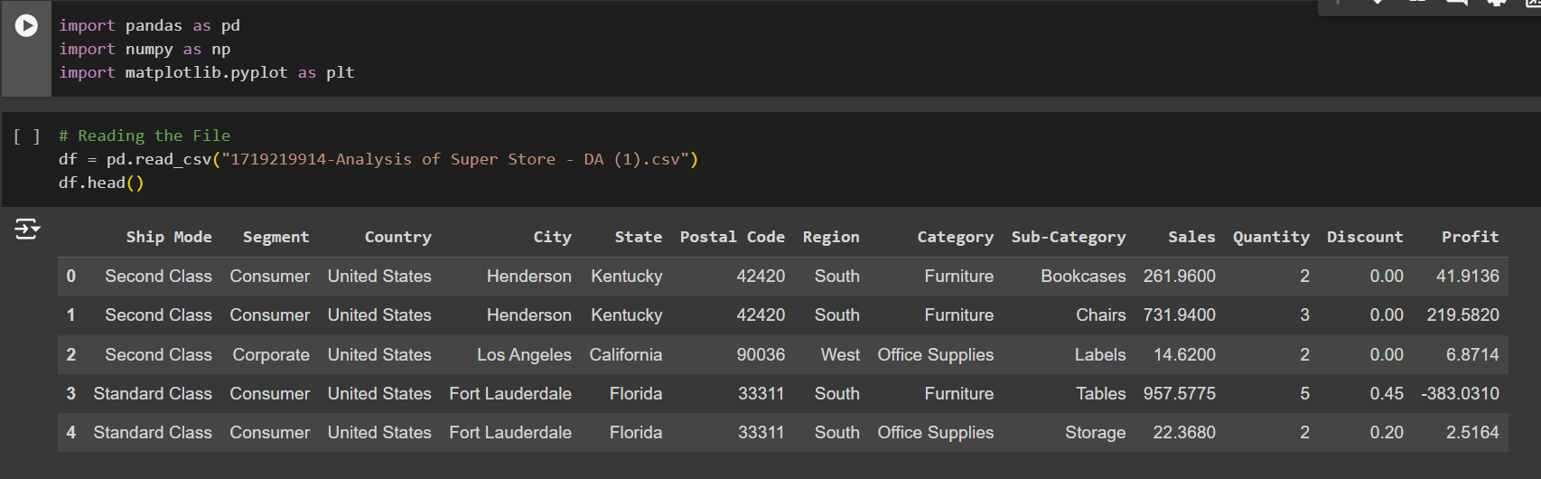
RESULTS
Here are the screenshots…
Link for Google Colab Notebook

Slide 7
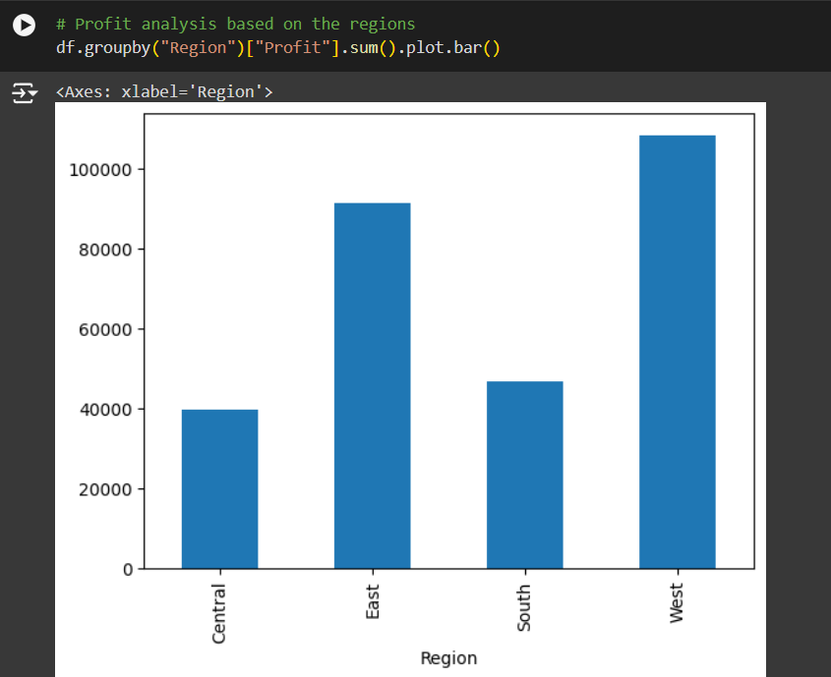
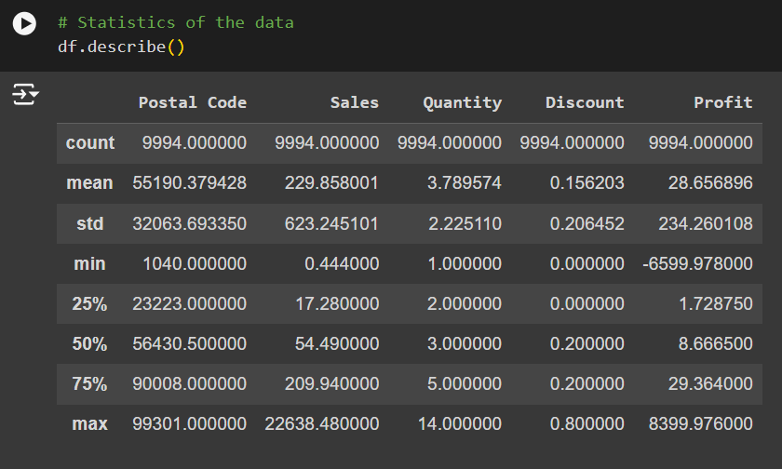
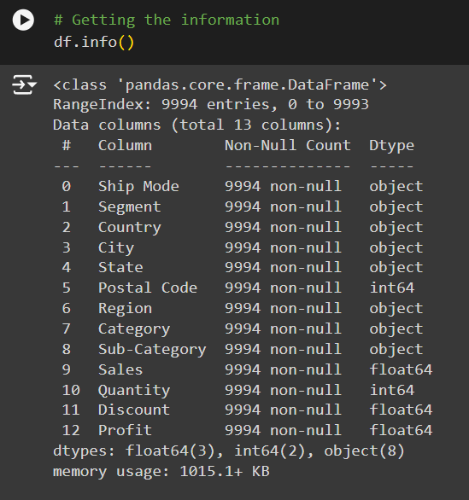
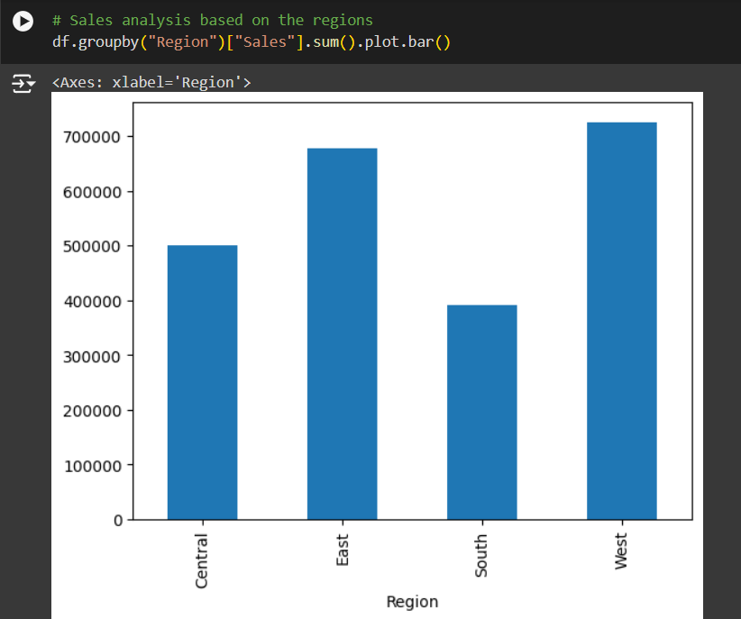

Slide 8
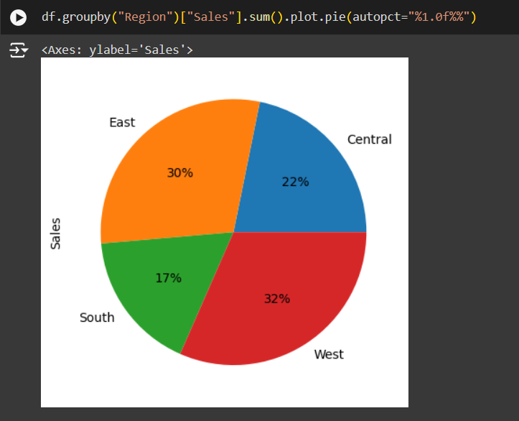
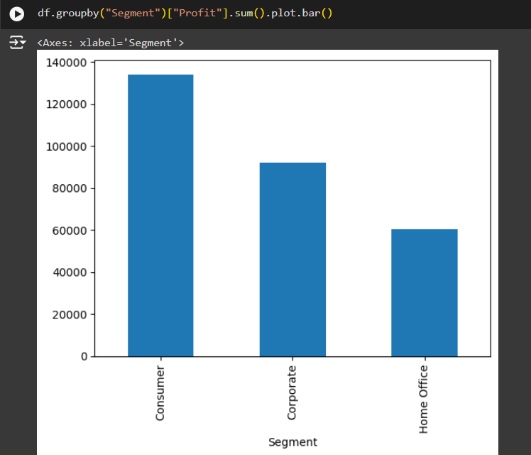
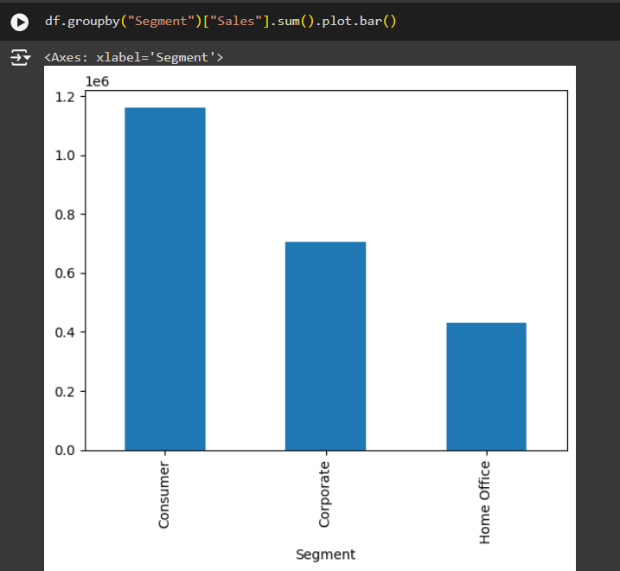

Slide 9
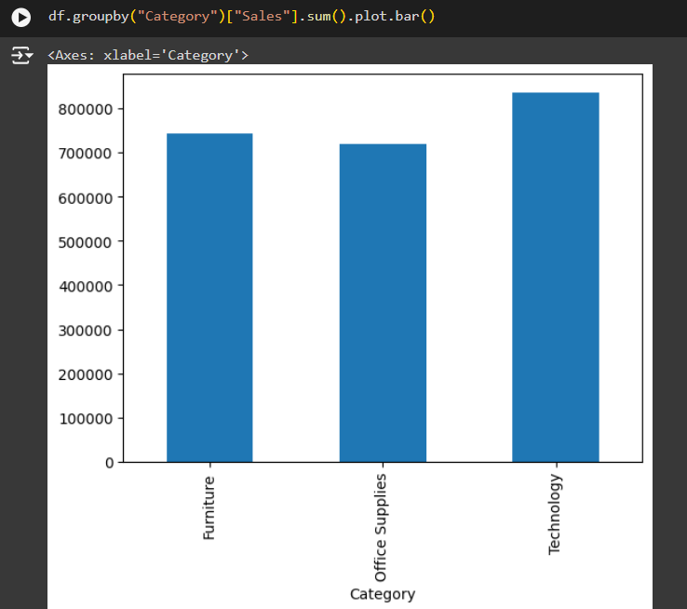
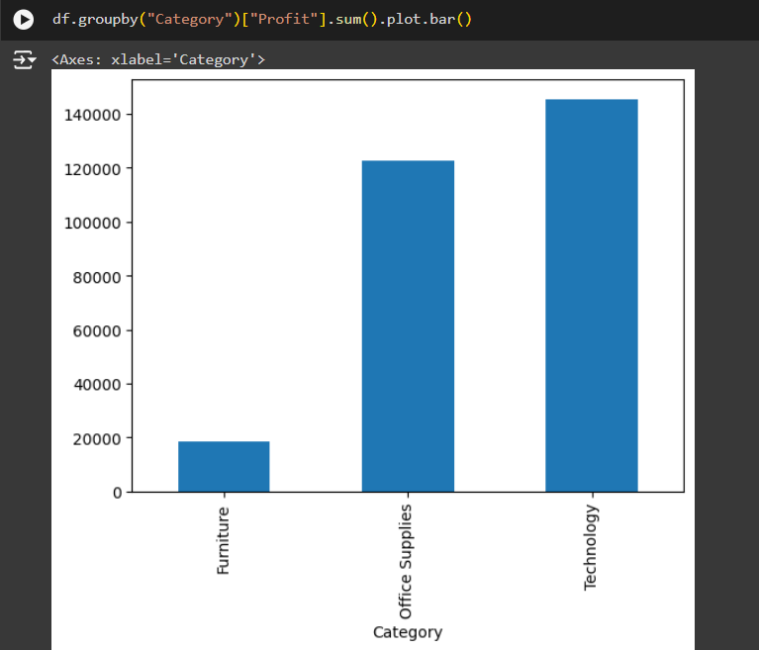

Slide 10
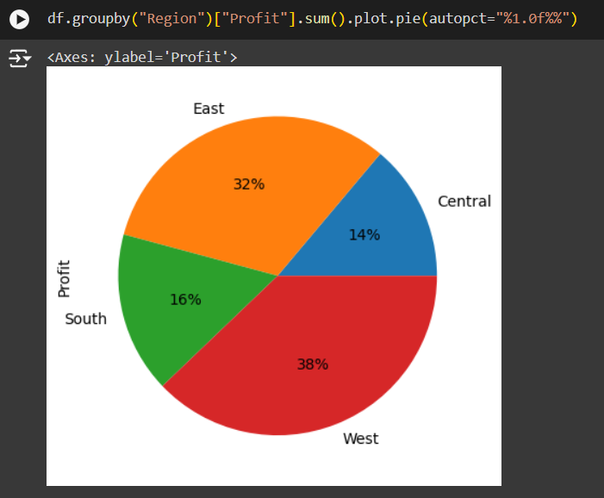
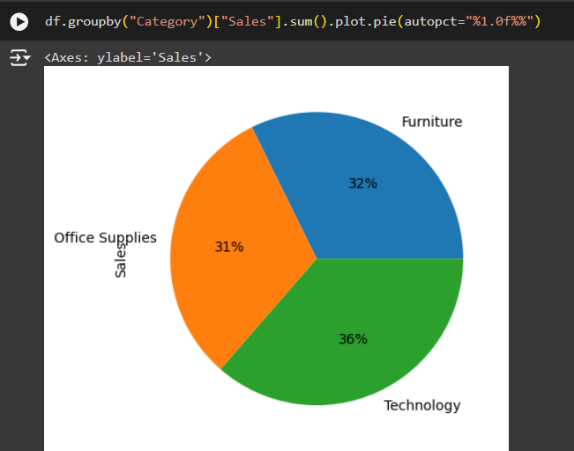
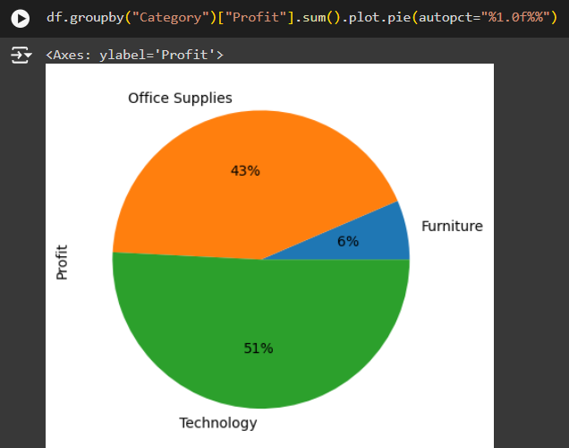

Slide 11
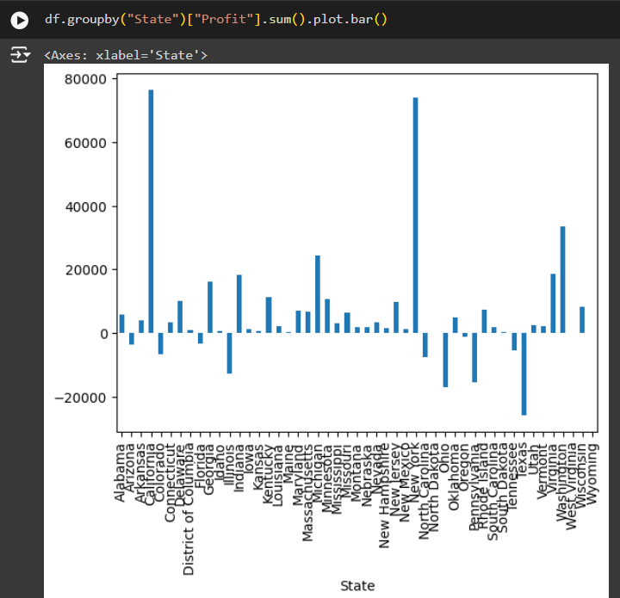
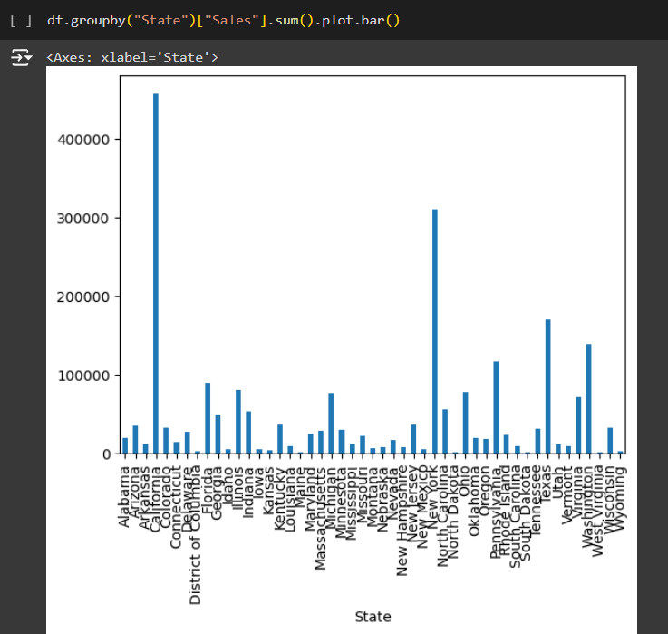

Slide 12
Thank you
From this perspective, the analysis of data within a superstore reveals immense insight into helping business strategies and increasing efficiency in operations.
Sales trends in the customer behavior have therefore provided such a highlight for improvement.
Data-driven decision-making here reflects that targeted marketing and optimized inventory management can be performed for helping the organization to modify market demands for desired growth.
.
.

